Slide 1
Workbook Cash Management
Internal Use Only
April 2017
EXCEL FILE:

Slide 2
Disclaimer
The content of this workbook has been produced by KPMG Germany/Deal Advisory on the basis of German accounting standards and/or IFRS, as well as considering KPMG Germany’s firm and country requirements, regulations, processes, policies and best practices. Please check your local accounting and other requirements before applying the content.

Slide 3
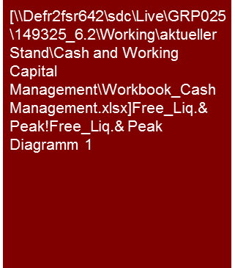
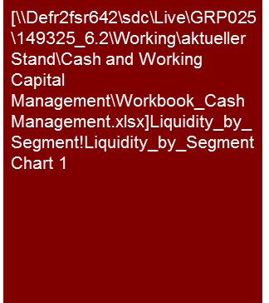
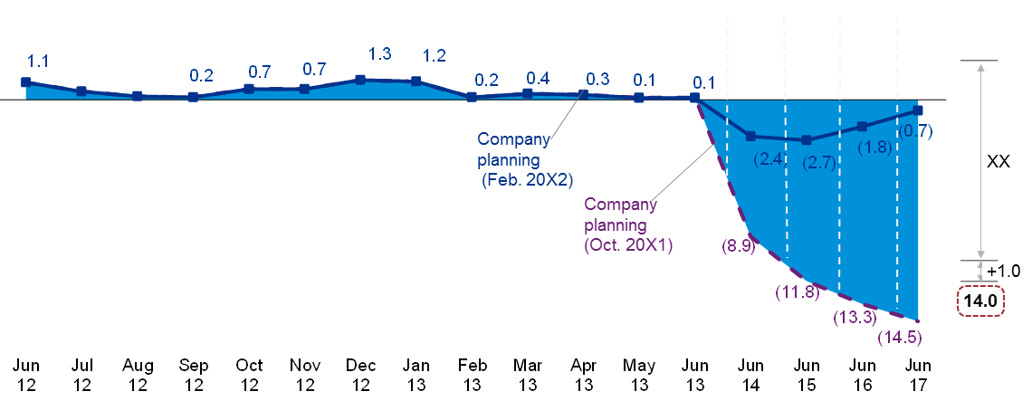
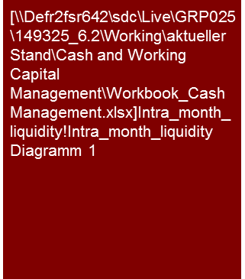
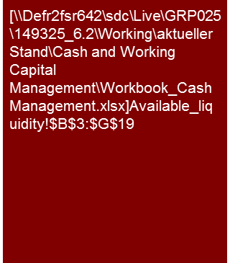
Overview (1/3) – Mission statement
Cash Management
Standard analysis used in this workbook reflect German standard and may differ in other regions.
Mission Statement:
Transparency on the liquidity development and forecast of liquidity shortfalls, development of measures optimizing Cash Management and covering financing deficits
Customer situation
Definition/Methodology/Tools of the basis analysis
Buy Side/Sell Side/JV
Development of the free liquidity
Primary drivers of liquidity development
Amount and time of potential financing deficit
Presentation of a systematic monthly estimate of the working liquidity
Turnaround/Restructuring
Cash effects of restructuring measures
Liquidity generating measures in the framework of Working Capital Management
Solvency test
1. Liquidity development and forecast
2. Cash flow by cash flow generating unit
Actual
Plan
3. Monthly liquidity development
4. Overview of available cash
2012
2013
Plan
J
F
M
A
M
J
J
A
S
O
N
D
J
F
M
A
M
J
J
A
S
Degree of standardization
3
4
1
4
4
3
4
Standardized presentation of the liquidity development possible
Sample slides
2
4

Slide 4
Overview (2/3) – Pitfalls
Cash Management
No. | Pitfalls/Lessons learned
 | Lack of involvement of the operational departments in the cash forecast generally results in imprecise/rough planning – 72% of the companies surveyed by KPMG have missed they cash forecasts significantly
 | Do not focus on internal data only. Unforeseeable events result in liquidity shortfalls – forecasts need to comprise of various liquidity development scenarios
 | Lack of clarity about the amount and time of material cash flows (deposits and payments) - 46% of companies surveyed by KPMG have underestimated their capital requirements, 26% have overstated their needs
 | Lacking availability of reliable data makes a detailed presentation of the liquidity challenging
 | Impulse to implement the fastest and simplest measures (e.g. stretching payment targets and shortening payment conditions) without taking the consequences into account (e.g. Illiquidity of an important supplier or rising bad debt losses)
 | Implementation of Cash Management is a cultural change process – it needs time, rules, goals and incentives and, last but not least, long-term management commitment
1
2
3
4
5
6

Slide 5
Overview (3/3) – Core issues
Cash Management
Core Issue | Specific analysis | Page(s)
Is there a reliable, i.e. methodically produced, liquidity planning on a monthly basis? | Course of various scenarios with presentation of the maximum current account line and the availment including a working liquidity (if applicable with plan-actual comparison) | 11-13
2. Is the liquidity for the next 13 weeks secured? | Chart and tabular overview of the short-term liquidity development (13 weeks) taking into consideration the current account line available | 14-15
What are the primary drivers for the liquidity development and what impact could potential shifts have on the liquidity position? | Chart of the primary drivers of the liquidity development | 16
Which cash flow generating units of the target contribute to material generation of liquidity (cash flow)? | Break down of the operational cash flow to the relevant cash flow generating unit (entities/segments/products etc.) level | 17
What is the peak financing need in the period under observation? | Presentation of the peak financing need including risk premiums and working liquidity assumption | 18
Is the liquidity secured on the effective date? | Table of the available liquidity and the payables due on effective date | 19
What is the systematic intra-month development of liquidity (as a basis for the determination of working capital financing needs)? | Presentation of the intra-monthly development of free liquidity | 20
What measures can be implemented to optimize liquidity? | Development and presentation of cash generating measures | 21-22

Slide 6
Definitions (1/5) – Cash Management
Cash Management
Strategic
Cash Management
Goal: Influence earnings and cost to maximize Free Cash Flow
Point of influence: P&L
Markets, Products, Customers
Suppliers
Processes
People
Tactical
Cash Management
Goal: Change the origin and use of capital to maximize Free Cash Flow
Point of influence: Balance Sheet
Working Capital Management [see also workbook Working Capital]
Investments
Non-Core Assets
Debt Restructuring
Pensions
Operational
Cash Management
Goal: Increase the short term payment capability of the company
Point of influence: Treasury
Cash Forecast [see also 13-W-Cash-Forecast Excel tool]
Cash Disposition
Cash Control

Slide 7
Definitions (2/5) – Operational Cash Management
Cash Management
Operational Cash Management (OCM)
Activities directly or indirectly increasing the short term payment capability of the company
The main constraint of these activities is to manage cash in the way that maximizes the profitability of the business
1
2
Cash Forecast
Cash Disposition
The main purpose of a Cash Forecast is the control and sustainment of liquidity (solvency)
The focus of the Forecast as well as measures to secure liquidity is short term (generally 13 weeks)
Cash disposition is the core of Cash Management
It covers the regulation of the cash outs as well as feedback loop to Cash Forecast and Cash Control
OCM
3
Cash Control
Cash Control ensures the quality of the forecast and disposition process.
This ex post deviation analysis of Plan vs. Actual payment data is the key element of iterative enhancement process of Cash Forecast.

Slide 8
Definitions (3/5) – Cash Forecast
Cash Management
OCM
1
Cash Forecast
Time period of the Cash Forecast is usually 13 weeks
The elements on the right are compulsory
Cash streams with third parties should be planned separately from the group internal cash streams
Cash Forecast is revised and adjusted on an ongoing weekly basis
Cash in
Trade receivables
Cash receipts from (existing & planned) customer orders
Advanced sales tax refunds
Interest receipts
Other receipts
Cash out
Trade payables
Operational
Cash Flow
Payments for (existing & planned) material orders
Sales tax prepayments
Payments for other operational expenses
Payments to personnel
Other recurring payments (other tax, rent, lease etc.)
Interest payments
Other non-recurring payments
Investment
Cash Flow
Cash in
Cash receipts from asset disposals
Cash out
Cash payments for investments
Tools
13-W-Cash-Forecast.xls
PPT template (see pg. )
Financing
Cash Flow
Cash in
New debt drawdown
Cash out
Debt repayments

Slide 9
Definitions (4/5) – Cash Disposition
Cash Management
OCM
2
Cash Disposition
Cash desk approves payment runs and ensures compliance with the decisions made during the cash flow forecasting process
It monitors daily liquidity status and assesses whether immediate actions are necessary
It prepares the actual data for the transfer to cash control tools
Provides input to cash forecasting concerning data, assumptions and processes
Calendar week
Monday
Tuesday
Wednesday
Thursday
Friday
Daily liquidity status
Daily liquidity status
Daily liquidity status
Daily liquidity status
Daily liquidity status
Order and payment overview
Payment run
Reports from:
Accounting
Procurement
Sales
Finance & Controlling
Weekly overview of payments and receipts
Cash Desk Meeting
Deviation analysis
Process control
Process improvement
Short-run adjustment of Cash disposition for the following week
Adjustment of 13-W-Cash Forecast

Slide 10
Definitions (5/5) – Cash Control
Cash Management
OCM
3
Cash Control
Ensure the quality (accuracy) of cash forecast and precise disposition
Ex post: Analysis of the deviation of the planned cash streams from the actual cash streams (amount and point in time)
Check: has the liquidity been used in the most optimal way?
Rolling improvement process (challenging assumptions, educating operational departments to increase accuracy, ensuring disposition follows guidance)
Controlling the transfer time and monitoring the float
Monitoring number and volume of the payments vs. transaction cost
Deviation analysis
Plan
Actual
Planned payments based on the input of operational departments, accounting and finance
Systematic transfer of actual payments and receipts in the cash forecasting tool
Operational
cash ins
Operational cash outs
Operational
cash ins
Operational cash outs
Divestments
Investments
Divestments
Investments
Financing cash ins
Financing cash outs
Financing cash ins
Financing cash outs
PLAN vs. ACTUAL
Analysis of causes for deviation (amount and timing) by category and individually for single largest items
Analysis of liquidity reserve and utilization of financing
Transfer of results (e.g. new information or process improvements) into the cash forecast process
Short-run adjustment of Cash disposition
Adjustment of the rolling Cash Forecast

Slide 11
1. Is there a reliable, i.e. methodically produced, liquidity planning on a monthly basis?
Cash Management
[... Following questions can be used to assess the methodology and accuracy of the liquidity planning currently used by the client...]
Is there a direct liquidity planning on a monthly rolling basis?
Are the operational divisions involved in the planning process on an ongoing basis?
How frequently is this planning being updated (monthly, weekly)?
How frequently is the liquidity status being reported on the cash generating unit level, company level, group level (daily, weekly, monthly)?
How frequently is the deviation analysis of the liquidity plan being performed (back-testing)?
Do all planning units use the same definitions, data basis and tools?
Are the cash management rules being followed by the operational divisions? How is this controlled and ensured?
Has a minimum liquidity reserve been defined? Have „asap“(immediate) measures increasing liquidity been defined for the case the minimum reserve is forecast to be underrun?
Are scenario analyses being performed regularly in order to identify potential liquidity short falls?
Does an aggregation of liquidity planning and liquidity management on the highest possible level (e.g. group) take place?
Have the legal (e.g. company law), contractual (e.g. covenants) and money transfer restrictions (e.g. transfer abroad) been accounted for during this integration process?
Are the decentered liquidity surpluses being monitored on an ongoing basis?
Are bank debt and other financing instruments being regularly evaluated in terms of volume and cost?

Slide 12
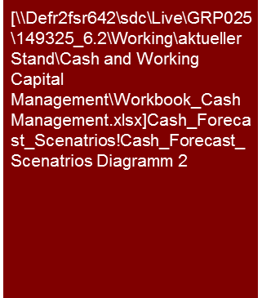
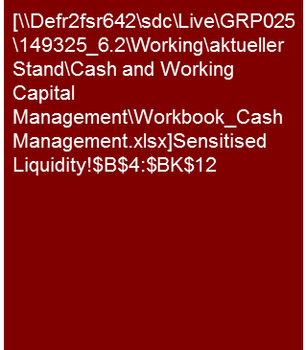
1. Is there a reliable, i.e. methodically produced, liquidity planning on a monthly basis?
Cash Management
Alternative 1
Corporate planning of XXX Group shows a liquidity gap of max. €4.3 million in Q3 2012.
Including working liquidity assumption of €10.0 million, an additional current account facility of €14.3 million is needed to cover this financing deficit.
Sensitized planning shows a gap of max. €14.0 million in the period from Q2 2012 to Q1 2014 (w/o working liquidity assumption).
XXX Group - Liquidity development and forecast (2011-2016, €m)
2011
2012
2013
2014
2015
2016
100.0
95.9
-32.3
Corporate planning
63.6
Sensitized
corporate planning
-0.5
15.4
- 11.1
14.0
10.0
- 25.4
Liquidity need including working liquidity assumption
Working liquidity
assumption
Additional liquidity need sensitized
planning w/o working liquidity assumption
Current account line
Additional current account facility needed (working liquidity assumption)
Financing gap corporate planning
(w/o working liquidity assumption)
Financing gap sensitized planning
(w/o working liquidity assumption)
Source: Company data, KPMG analysis

Slide 13
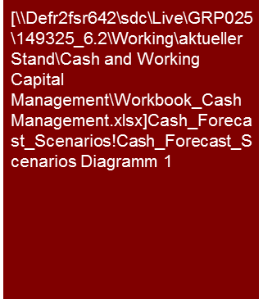
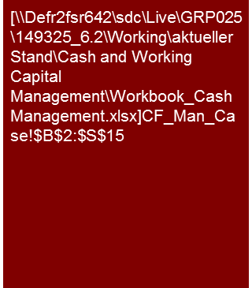
1. Is there a reliable, i.e. methodically produced, liquidity planning on a monthly basis?
Cash Management
Alternative 2
Compulsory content:
major assumptions of corporate planning (Management Case),
working liquidity assumption,
which assumptions have been sensitized and to what extent,
what is the resulting cash need,
When will the peak be reached
Calculated availment of current account line of the ABC-GmbH
2013: Liquidity ∆ -27.1
2014: Liquidity ∆ -31.8
2015: Liquidity ∆ +3.3
2016: Liquidity ∆ +7.5
EBITDA: ∆ +21.6
NWC: ∆ -23.4
Investment CF: ∆ -45.9
EBITDA: ∆ +26.8
NWC: ∆ -1.0
Investment CF: ∆ -35.0
EBITDA: ∆ +37.7
NWC: ∆ -1.6
Investment CF: ∆ -25.9
EBITDA: ∆ +41.1
NWC: ∆ -3.5
Investment CF: ∆ -25.4
Corporate planning: - € 41.0 m per 31. Mai 2015
Sensitization: - € 53.2 m per 31. Mai 2015
Sensitization including working liquidity: - € 63.2 m per 31. Mai 2015
Peak liquidity need in May 2015
+23.9
-24.6
-12.2
-10.0
Working liquidity
Source: Company data, KPMG analysis

Slide 14
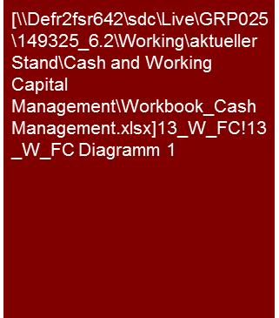
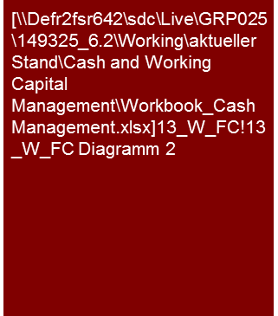
2. Is the liquidity for the next 13 weeks secured? (1/2)
Cash Management
Alternative 1
Compulsory content:
major assumptions of corporate planning (Management Case),
working liquidity assumption,
which assumptions have been sensitized and to what extent,
what is the resulting cash need,
When will the peak be reached
Is the gap greater than 10% of payments due?
Can the liquidity gap be covered in short term?
ABC-GmbH – 13 weeks liquidity forecast (€m)
June 2013
July 2013
August 2013
September 2013
ACTUAL
FORECAST
1
1
2
1
Available current account line of € 12.0 m
sensitized
Free liquidity
Mgmt Case
Working liquidity
Short-term liquidity development
The short-term, daily liquidity planning always approaches the mid-term liquidity planning at the end of the month.
No repayments of the bank loans are planned in the period form June to September 2013.
Working liquidity has been estimated based on past data and amounts to € 12,5 m
The liquidity planning considers the net liquidity outflows for investments in [...] of €x.x m in July 2013 and €x.x m in August 2013.
For mid-September 2013 an increase of liquid means of €x.x m Is planned through the sale of a piece of property in xxx. The property was originally planned for the extension of the site that is no longer necessary as a result of the new site in xxx.
Management case includes planned divestments as well as sales volume growth higher than market average. Small overdrafts on the current account would have to be eliminated by short-term liquidity control measures.
Without the consideration of the planned sales earnings (Sensitized Case) , there would be a short-term gap in liquidity from the middle to the end of September 2013. This gap does not exceed 10% of payments due and is only contemporary according to the mid-term plan in the Sensitized Case.
1
2
Source: Company data, KPMG analysis

Slide 15
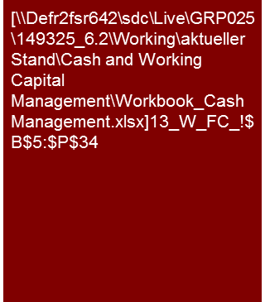
2. Is the liquidity for the next 13 weeks secured? (2/2)
Cash Management
Alternative 1
Compulsory content:
major assumptions of corporate planning (Management Case),
working liquidity assumption,
which assumptions have been sensitized and to what extent?
What is the resulting cash need?
When will the peak be reached?
Is the gap greater as 10% of payments due?
Can the liquidity gap be covered in short term?
...
Note: Net liquidity = Cash (+) less availment of current account line (-)
Available liquidity (+): free line (+) plus cash (+) or line less net liquidity
capital needs (-): free line (+/- 0) plus capital needs (-)
Source: Company data; KPMG analysis.

Slide 16
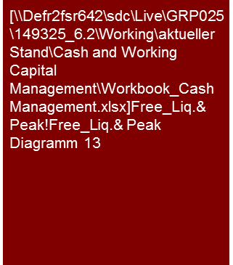
3. Material drivers for the development of liquidity
Cash Management
Alternative 1
Compulsory content:
nature and impact of the drivers of liquidity development
Presentation of the material drivers for the development of liquidity (€000)
Actual
Plan
4
1
3
2
6
5
Payments received by xxx for participation in xxx of €x.x m net.
1st rate income for xxx of €x.x m net.
Payments for personnel costs of ca. €x.x m As well as other operating expenses of ca. €3.6 m. The payment of which is offset by the 2nd rate earnings for the period 20xx/20xx of €1.0 m net.
4th rate earnings for xxxx of €1.2 m; Net and payment of €2.2 m; Offset by the payment of a partial sum to xxx of €x.x m.
Payment received 2nd rate earnings for xxx of €x.x m and planned taking of the loan of €x.x m. That will be completely compensated for by personnel costs and other operating expenses. Alternatively to drawing down the credit, the management is attempting to avoid taking the loan by renegotiating payment periods for trade payables as well as advance financing of earnings.
Payments primarily for personnel costs (€x.x m) and other operating expenses (€x.x m).
1
2
3
4
5
6
Source: Company data, KPMG analysis

Slide 17
4. Transfer of free liquidity according to segments
Cash Management
Alternative 1
Compulsory content:
major drivers of liquidity development in the individual segments
Development of cash flow (€m)
20XX
20XX
+ € XX m
€ XX m
Thereof:
Investment payments € -XX m Sales revenues € +XX m
Operative cash flow 20XX: € -XX m Thereof YTD April 20XX: € -XX m
February 20XX: € XX m
March 20XX: € XX m
April 20XX: € XX m
Source: Company data.
Thereof: Inflows from shareholders € +XX m Repayments € -XX m
Interest € -XX m
Change leasing/other € -XX m
Thereof:
xxxx € -XX m
xxxx € +XX m
xxxx € -XX m
xxxx € +XX m
Including € XX m repayment xx December 20XX

Slide 18
5. Determination of the peak liquidity needs
Cash Management
Alternative 1
Compulsory content:
Peak financing need (how much, when)
Assumptions on risk premiums and working liquidity (how much, why)
Determination of the amount and time of the peak financing needs
Actual
Plan
Shortfall:
€-XX m
2
3
Beginning of shortfall as per planning Feb. 20x2
Company planning
(Feb. 20X2)
XX
1
Company planning
(Oct. 20X1)
Beginning of shortfall as per planning Oct. 20X1
+1.0
4
14.0
Risk premium/ Working liquidity
General
The development shown above of the mean cash on hand of the xxx shows a shortfall of €x.x m. At the end of xxx according to the planning of February 20xx. This sum contains €1.0 m for a risk premium and the working liquidity.
Development of the cash on hand
In accordance with the corporate planning from October 20xx a shortfall was already witnessed in November 20xx.
By contrast the xxx witnessed a shortfall as per corporate planning from February 20xx only in June 20xx of €x.x m.
The shortfall of xxx at the end of 20xx/xx will total €13.0m according to corporate planning from February 20xx.
A risk premium of €1.0m will lead to an increase of the shortfall to €14.0m
1
2
3
4

Slide 19
6. Overview of available liquidity (table)
Cash Management
Alternative 1
Compulsory content:
Table of the available liquidity and the payables due on effective date
Free liquidity (how much, main drivers/assumptions
Calculated availment of current account line of the ABC-GmbH
Available liquidity
As per 31 May 201x the group has free liquidity of €28.2m. This results primarily from the deposit of the capital contribution by the shareholders of €40.0m in the period February to April 2013.
By means of active creditor management payments due are regularly shifted. As per 31 May 201x due creditors of €2.3m existed.
Source: Company data.

Slide 20
7. Liquidity systematic within the month for estimation of the working liquidity assumption
Cash Management
Alternative 1
Compulsory content:
Presentation of the intra-monthly development of free liquidity
Main drivers of spread
Separation of repayments and investments
Estimation of max. fluctuation range of working capital
Schematic presentation of the development of the free liquidity (June 20x3, €m)
20x2
20x3
Plan
€ XX m Investment payments
J
F
M
A
M
J
J
A
S
O
N
D
J
F
M
A
M
J
J
A
S
Deposits by shareholders
€ XX m Invest.
4
€ XX m Invest.
3
4
€ XX m Invest.
1
4
3
2
4
4
Max. fluctuation range € XX m
Schematic seasonality
The liquidity is subject to large fluctuations in a month. These primarily range within ca. €10 m (working liquidity) (without consideration of the capital contribution measures). In a normal business situation the free liquidity available is highest at the beginning of the month. At the end of the month payments for salaries and social security are due. Delayed debtor payments (especially ABDC) may result in liquidity bottlenecks toward the end of the month (condition from main customer ABCD: 14-day invoicing with payment period of 14 days).
Sales earnings from the sale of the xx companies increases the liquidity by €18.4 m in January 20x2.
A part of the purchase price of € xx k was used in January 20x2 to repay the deferred repayment rates
Repayment of € 5.0 m. Each at the end of March 20x2 and the end of December 20x2
Increase of the free available liquidity through payment of the capital provisions by the shareholder:
15 March 20x2: €5 m
20 March 20x2: €20.0 m
9 November 20x2: €10.0 m
8 February 20x3: €10.0 m
13 March 20x3: €10.0 m
29 April 20x3: €20 m
3
4
€35.0 m in FY20x2
1
€ 40.0 m in YTD20x3
2
Note: Free liquidity = Cash plus free current account line; (a) The maximum fluctuation range results from the difference between minimum and maximum cash in the bank – adjusted by capital contribution measures.
Source: Company data.

Slide 21
8. What measures can be implemented to optimize liquidity?
Cash Management
Examples measures
Strategic
Adjust cash processes
Structural
Change business model
High risk
Less capital intensive production and logistics channels
Debt restructuring
Redefine supply chain
Cost cutting (operational & G&A)
Divest cash burning business units
Terms & Conditions (esp. cash discounts)
Optimize Order-to-cash
Decrease DSO
Tactic
Optimize Forecast-to-fulfil
Incentivize cash management
Adjust product portfolio (incl. design & production)
Pre-payments
Get pensions off-balance
Optimize location portfolio
Investments
Payroll tax
Direct & indirect tax
Introduce cash KPI for procurement, production & sales
Get pensions off-balance
Reduce collection period
Reduce inventory
Tactical Cash Management
Manage working capital throughout the supply chain
Strategic Cash Management
Operational
Operational Cash Management
Stakeholder management and communication inclusive cash performance
Overdue debt collection
Increase DPO
Optimize Purchase-to-pay
Low risk
Cash in control
Reduce purchase
Cash Pooling & Cash Flow Forecasting
Divest non-core assets
Short term
Mid term
Long term

Slide 22
8. What measures can be implemented to optimize liquidity?
Cash Management
Alternative 1
The significant reduction of Capital Employed was the core element of the value increase program of the ABCD group.
Implementation of measures recommended by KPMG has led to a ROCE increase of 15%.
Tactic measures
Closure
BU „XYZ“
EBIT
Re-organization R&D
Relocation of production to Asia
Strategic measures
Re-engineering
procurement
& production
Overhead reduction
Outsourcing of BU
Operational
measures
Value analytics
Cooperation BU “ZUI“
Capital Employed
Reduction Slow Moving Stock
Sale of BU
Reduction of production locations
Payment targets
Optimization of Cash processes
Debt collection
Short term
Mid term
Long term

Slide 23
© 2017 KPMG International Cooperative (“KPMG International”). KPMG International provides no client services and is a Swiss entity with which the independent member firms of the KPMG network are affiliated.

